Slide 1
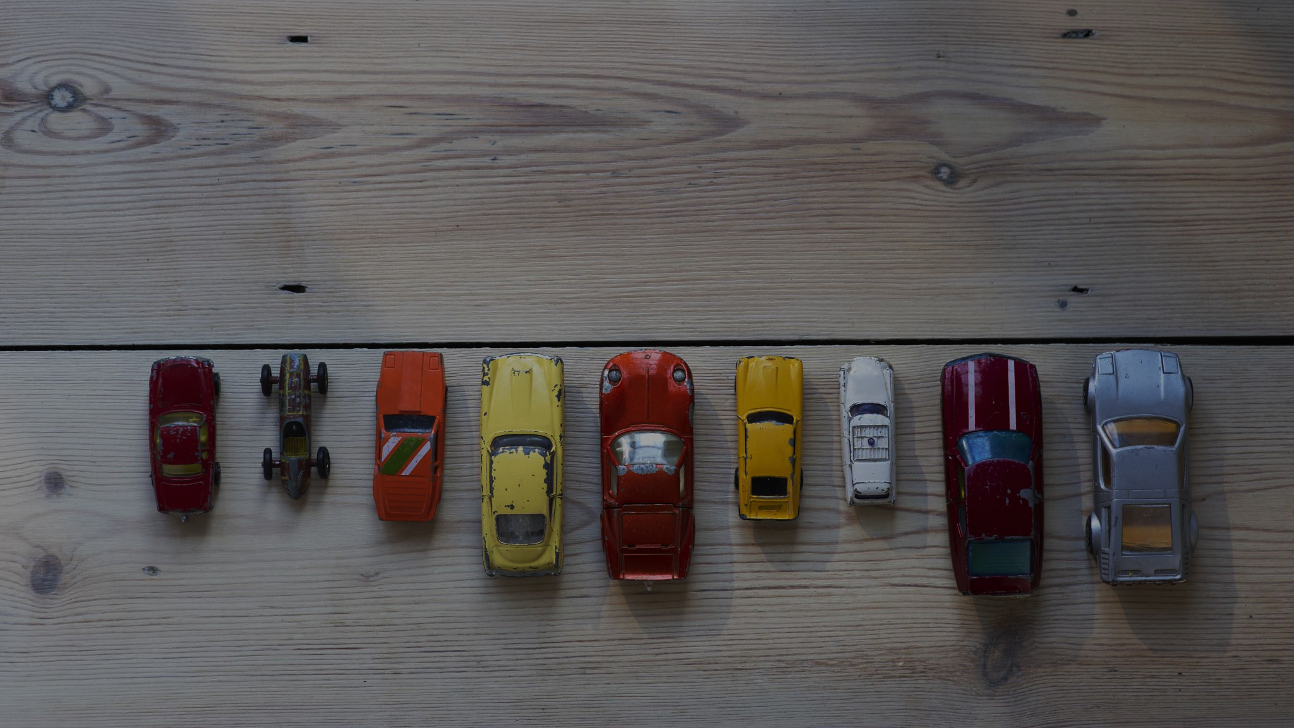
Used Cars Price Prediction

Slide 2
PROBLEM STATEMENT
We need to use our data exploration skills and find out the importance of each variable in predicting the price of used car
Specifically, we want to understand the factors affecting the pricing of cars, which variables are significant in predicting the price of a car, how well those variables describe the price of a car.
The task at hand for us is to predict the price of used car appropriately based on the existing data using machine learning algorithms.

Slide 3






What’s our approach?
Understanding the data
Exploratory Data Analysis
Data Pre-processing
Modelling
Evaluation

Slide 4
Dataset Dissected
Attribute | Description
Name | The brand and model of the car
Location | The location in which the car is being sold or is available for purchase
Year | The year or edition of the model
Kilometers_Driven | The total kilometers driven in the car by the previous owner(s) in KM
Fuel_Type | The type of fuel used by the car
Transmission | The type of transmission used by the car
Owner_Type | Whether the ownership is Firsthand, Second hand or other
Mileage | The standard mileage offered by the car company in kmpl or km/kg
Engine | The displacement volume of the engine in cc
Power | The maximum power of the engine in bhp
Seats | The number of seats in the car
New_Price | Price of new model
Price | The price of the used car in INR Lakhs

Slide 5
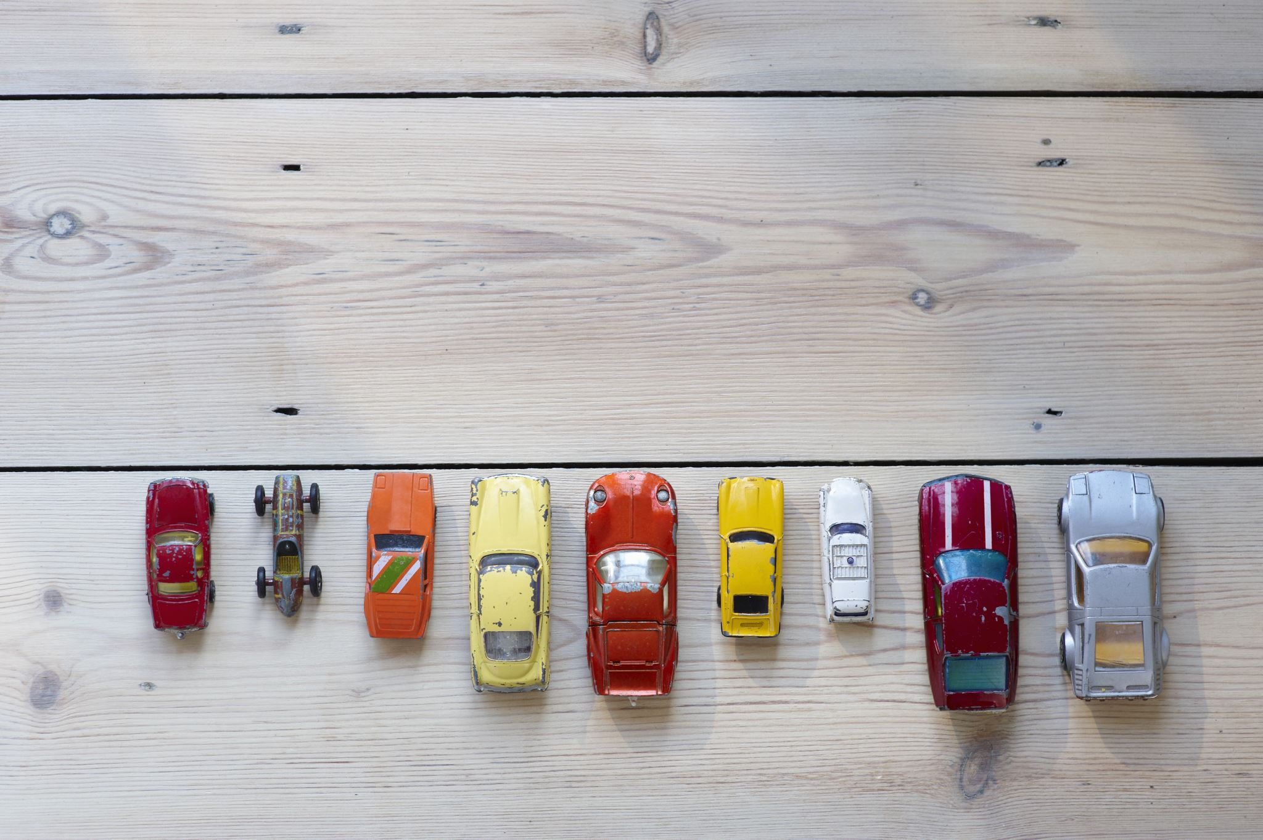
Name
The brand and model of the car
Sample Values
Out of the 6019 records, we’ve 1876 unique car names.
We’ve used this variable to understand the make and model of each car
We’ve 212 different models of cars belonging to 31 different brands.
Maruti and Hyundai rule over 40% of this competitive market
Maruti Wagon R LXI CNG
Honda Jazz V
Audi A4 New 2.0 TDI
Hyundai i20 Magna
Year
Price of new model
Sample Values
Edition/year of cars ranges from 1998 to 2019
Highest number of sold were manufactured in 2014, followed by 2015 and 2016
The cars manufactured from 1998 to end of 2001 are less preferred.
2000
2010
2017

Slide 6
Location
Location in which car is being sold
Sample Values
Mumbai
Hyderabad
Kochi
There are 11 distinct location where car has been sold.
Most of cars are sold in Mumbai(~780), followed by Hyderabad and Kochi
Least number of cars were sold in Ahmedabad(~210).
Fuel Type
Type of fuel used by car
Sample Values
Petrol
Diesel
Diesel cars are the most frequently sold cars followed closely by Petrol.
CNG, LPG and Electric are very less in number.
Transmission
Type of transmission used by car
Sample Values
Manual
Automatic
Majority of cars (approx. 4000) have manual transmission.

Slide 7
Owner Type
Whether the ownership is 1st hand or 2nd hand or other
Sample Values
First owned car
Second owned car
First owned cars predominate our dataset, followed by second, third and fourth and above.
As the ownership moves from first to second to third and beyond, the price is
decreasing, which is expected naturally.
Mileage
Mileage offered by the car
Sample Values
26.6 Km/Kg
19.67 Kmpl
Mileage is present in 2 different units like km/kg and kmpl.
Missing and incorrect values were present in Mileage feature.
Engine & Power
Displacement of volume & max power of the Engine
Sample Values
Engine: 1998 CC
Power: 58.16 bhp
Majority of cars have less than 1900 cc as engine size.
Engine and Power are highly corelated, so we can work with either of the feature.

Slide 8
Seats
Number of seats in car
Sample Values
Most of the sold cars are 5-seater. Followed by 4-seaters
Average price of 2-seater cars is the highest of all.
Missing values are present in Seats, which can be imputed based on the brand and model of car.
3
5
7
New Price
The year/edition of model
Sample Values
The missing value in New Price is quite high, about 86.31% values are missing.
This could be because of the new model of the car may no longer be manufactured or car is the latest model;
Hence, they do not have New Price value. Therefore, we will drop this column.
15.27 lac,
1.25 cr

Slide 9
Insights
First-hand owned, Manual Transmission cars which run on diesel or petrol and are 5 seaters are favored by the customers - more than 48% of the cars fall under this category.
Diesel cars have the highest average price while CNG and LPG have the least. But the mileage is observed to be the highest among the CNG and LPG fuel types.
Automatic transmission cars are highly expensive in comparison to Manual transmission, although they provide lesser mileage

Slide 10
Thank you

